Slide 1

OLIST STORE ANALYSIS
PRESENTED BY
N E E T E S H S A X E N A

Slide 2



OBJECTIVE
The olist store analysis project aims to analyze customer purchasing patterns and payment statistics on an e- commerce platform. This project covers several key performance indicators (kpis) such as weekday vs weekend sales, payment statistics, delivery time ,and customer behavior. The analysis is based on nine csv files, which are cleaned and manipulated to extract valuable insights including sales trends ,customer behavior
OLISTS STORE ANALYSIS
,product performance and segmentation. By examining
marketing historical
transactional data , demographic information , and customer feedback

Slide 3

Data Schema: The Olist Store dataset is structured as a relational database, with multiple tables that are interconnected to provide a comprehensive view of the e-commerce operations. The relationships between the tables can be visualized using an Entity-Relationship (ER) diagram. Here is an overview of the tables and their relationships:
OLISTS STORE ANALYSIS

Slide 4
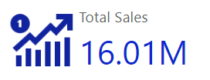
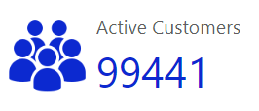


Performance Overview :
Olist Generated Total Sales of 16.01 M over the period of 2016-2018
OLISTS STORE ANALYSIS
The total customer count stands at 99441. This metric quantifies the size of the customer base, a fundamental aspect of understanding a business's reach and potential market.
The Platfrom has an average review score of 4.09. This reflects the overall customer satisfaction with products and services, with a higher score indicating positive feedback and quality.
Avg Shipping Days
12
The KPI card presents the average delivery time, indicating orders are typically delivered in 12 days. A lower number signifies efficient shipping processes, enhancing customer satisfaction and trust.
Repeat Customers
2997
A total of 2997 customers have made repeat purchases and accounted for 6% of total sales

Slide 5
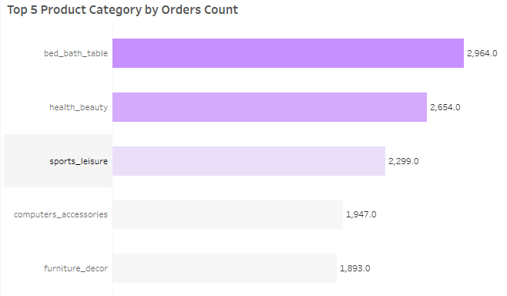
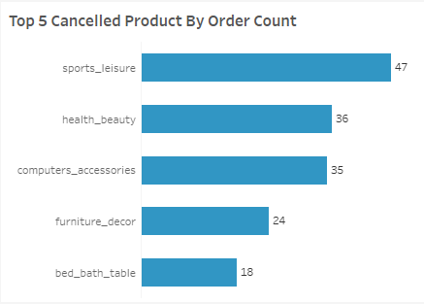
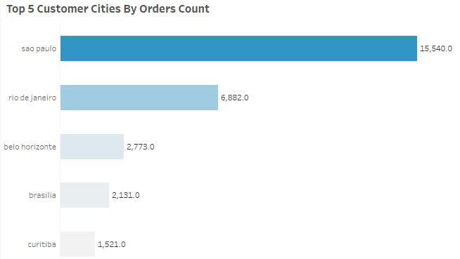
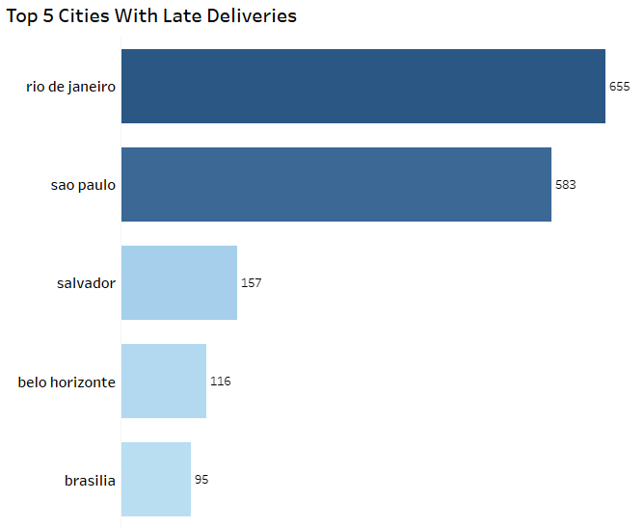
Product & Delivery Performance Overview
Bed bath table is the most ordered product by customers followed by health beauty, however concerns arises as we look at the maximum orders that are cancelled includes sports leisure one of the top 3 products
Suggestions:
Detailed analysis is needed for the reasons behind cancellations including product quality being delivered, shipment delays, competitive pricing
OLISTS STORE ANALYSIS
Sao Paulo and Rio de Janerio are the top two cities which contribuited to maximum orders however concerns arises as we look at orders that are delivered late includes our top 2 Cities
Suggestions:
Detailed analysis is needed for the reasons behind cancellations including product quality being delivered, shipment delays, competitive pricing

Slide 6

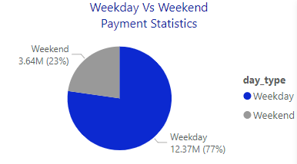
Weekday Vs Weekend Payment Statistics
Observations:
weekend contributes to 23% of the payment while weekdays day contributes to 77% of payment.
Conclusion:
payment contribution on weekends is less when compared to weekdays.
Suggestions:
--Weekend-Specific Promotions: Offer exclusive deals, discounts, or promotions during weekends to incentivize spending and attract more customers. Highlighting limited-time offers or special weekend events can create a sense of urgency and drive sales.
--Product Mix Optimization: Analyze which products or services perform well during weekdays versus weekends. Adjust your product mix or inventory levels to better align with weekend consumer preferences and cater to their needs effectively.
OLISTS STORE ANALYSIS
KPI-1

Slide 7
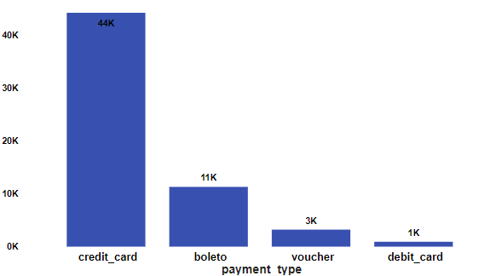
Number of Orders with review score 5 and payment type as credit card.
Observations:
number of orders for reviews score five are 45K with the payment type as credit card.
Conclusion:
The high number of orders with a review score of 5 and payment type as credit card suggests a strong correlation between customer satisfaction and payment convenience, potentially indicating a positive customer experience and trust in the credit card payment method.
Suggestions:
--Incentivize Credit Card Usage: Implement incentives or rewards programs specifically targeted at customers who choose to pay with credit cards. Offer cashback rewards, loyalty points, or exclusive discounts for credit card transactions to incentivize their usage and encourage repeat business.
--Educational Resources: Provide educational resources or guides to help customers understand the benefits and security features of credit card payments. Offer tips for safe online shopping practices and information about fraud prevention measures to build trust and confidence in credit card transactions.
OLISTS STORE ANALYSIS
KPI-2

Slide 8
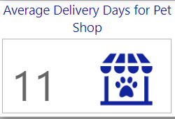
Observations: average number of days taken for order to be delivered for pet shop are 11 Conclusion: The shorter average delivery time for "pet_shop" orders indicates efficient and timely delivery processes, enhancing customer satisfaction and competitive advantage. Suggestion: --Invest in Technology: Leverage technology solutions such as route optimization software, predictive analytics, and automated order processing systems to streamline delivery operations and improve efficiency --Focus on Packaging Efficiency: Optimize packaging materials and processes to reduce packaging waste and minimize packaging dimensions.
Average number of days taken for delivery for product pet shop
KPI-3
OLISTS STORE ANALYSIS

Slide 9
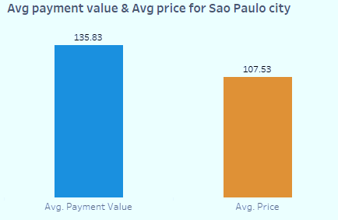
Observations: The Average price is 107.53 and Average Payment Value is 138.83 for Sao Palo city. Conclusion: provides insights into the spending behavior and purchasing power of this demographic segment, aiding in market analysis and business strategy formulation. Suggestion: --Partnerships with Local Businesses: Collaborate with local businesses or influencers within São Paulo city to gain a better understanding of the local market dynamics and consumer preferences. Partnering with local brands or organizations can help tailor products and services to better meet the needs of São Paulo customers. --Localization of Marketing Campaigns: Develop localized marketing campaigns and promotions specifically targeted at customers in São Paulo city. Highlight products or services that resonate with the local culture, preferences, and lifestyle trends to attract and engage this demographic segment effectively.
Average price and payment values from customers of sao paulo city
KPI-4
OLISTS STORE ANALYSIS

Slide 10
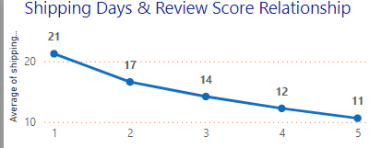
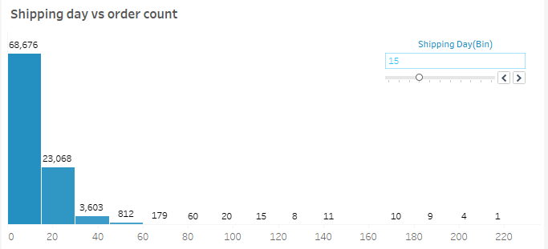
Observation: Review scores of 4 and 5 have notably lower average delivery days compared to scores of 1, 2, and 3. This indicates that customers who give higher review scores tend to experience faster delivery times, contributing to their overall satisfaction. Conclusion: Higher review scores correlate with shorter delivery times(indicates negative correlation), with the most significant impact on satisfaction seen at lower review scores. Suggestion: --Invest in Logistics Infrastructure: Upgrade logistics infrastructure and distribution networks to improve delivery speed and reliability. Expand warehousing facilities, optimize inventory management, and establish strategic partnerships with reliable shipping carriers to minimize transit times. --Utilize Express Shipping Options: Offer express shipping options for customers who prioritize faster delivery. Provide expedited shipping services with guaranteed delivery times for an additional fee to cater to time-sensitive orders and enhance customer satisfaction.
Relationship between shipping days Vs review scores.
KPI-5
OLISTS STORE ANALYSIS

Slide 11







KEY INSIGHTS
OLISTS STORE ANALYSIS
-- The company has a 97% delivery success rate with 96,478 orders being delivered, The average order cancelation rate is 0.63% (Less than 1%)
-- Olist had a monthly average of 8,657 orders placed on their platform
-- Customers revisiting the platform and making a repeat purchase is as low as 3.01%
-- 72% of the Transcations were Carried out using Credit card followed by boleto at 19.16%
-- The analysis of payment statistics based on weekday vs. weekend provides an understanding of the buying behavior of customers and can also help Olist to improve their weekend sales and plan promotions accordingly
-- There is a negative correlation between the review score and the average shipping days. Lesser the number of shipping days, higher the review score and vice-versa.

Slide 12
ADDITIONAL INSIGHTS
--Frequent Purchase Analysis:
Identify top 10 product categories by order frequency, Bed bath table (Cama_mesa_banho) most frequently purchased with 10K orders
--Profit Margin Analysis:
Evaluate each product's profit contribution , Signaling and security (Sinalizacao_e_seguranca) has highest profit margin of 79%, Home appliances 2 (eletrodomesticos_2) has least profit margin (11.1%).
OLISTS STORE ANALYSIS

Slide 13
RECOMMENDATIONS
--Loyalty programs such as special discounts for repeat customers and free shipping to targeted locations like Sao Paulo and Acre can be implemented to drive increase in repeat purchases, increase in customer retention, and acquisition of new Customers.
--Geographical Analysis:
Understand customer distribution, Identify new market opportunities , Highlight high-demand areas with longer delivery times or higher shipping costs, Optimize delivery routes and logistics for efficiency and cost reduction
OLISTS STORE ANALYSIS

Slide 14






Thank you

